Slide 1

Biblical Prophecy
• What is it?
• Is it here today?
Dr. Rick Griffith • Jordan Evangelical Theological Seminary • BibleStudyDownloads.org

Slide 2
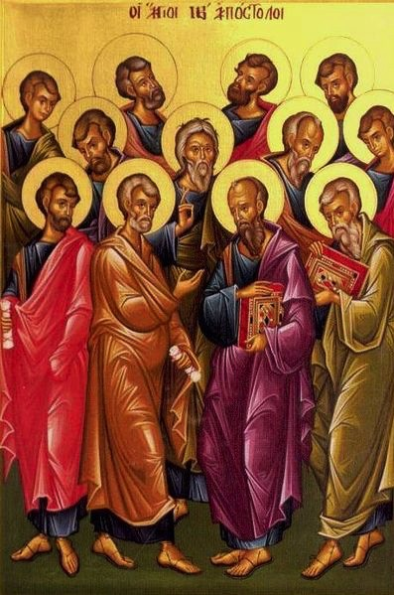
Are there apostles today?
20
God's household (the church) is:
"built on the foundation of the apostles and prophets, with Christ Jesus himself as the chief cornerstone"
(Eph. 2:20)

Slide 3

God's Household (Eph. 2:19-22)
19
Non-Equipping Gifts
(Eph. 4:12b)
Pastor-Teachers
Evangelists
Teachers
Equipping Gifts
(Eph. 4:11-12a)
Foundation: Apostles & Prophets (Eph 2:20)
Foundation: The Lord Jesus Christ (1 Cor. 3:11)
Adapted from Charles R. Swindoll. "Spiritual Gifts Study Guide" (IFL, 1983), 7

Slide 4
Are there prophets today?
20
God's household (the church) is:
"built on the foundation of the apostles and prophets, with Christ Jesus himself as the chief cornerstone"
(Eph. 2:20)

Slide 5
God's Household (Eph. 2:19-22)
19
Non-Equipping Gifts
(Eph. 4:12b)
Pastor-Teachers
Evangelists
Teachers
Equipping Gifts
(Eph. 4:11-12a)
Foundation: Apostles & Prophets (Eph 2:20)
Foundation: The Lord Jesus Christ (1 Cor. 3:11)
Adapted from Charles R. Swindoll. "Spiritual Gifts Study Guide" (IFL, 1983), 7

Slide 6
Gifts in Order of Importance
21
22
1 Cor. 12:8
Word of wisdom
Word of knowledge
1 Cor. 12:28
Apostles
Prophets?
Teachers?

Slide 7
Gifts in Order of Importance
21
22
1 Cor. 12:8
Word of wisdom
Word of knowledge
1 Cor. 12:28
Apostles
Prophets?

Slide 8
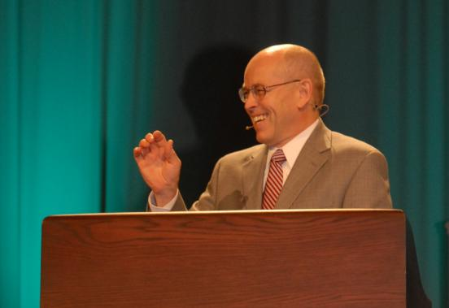
Wayne Grudem's
Definition of Prophecy
124
"telling something that God has spontaneously brought to mind"
"Why Christians Can Still Prophesy" Christianity Today (16 Sept 1988), 29

Slide 9
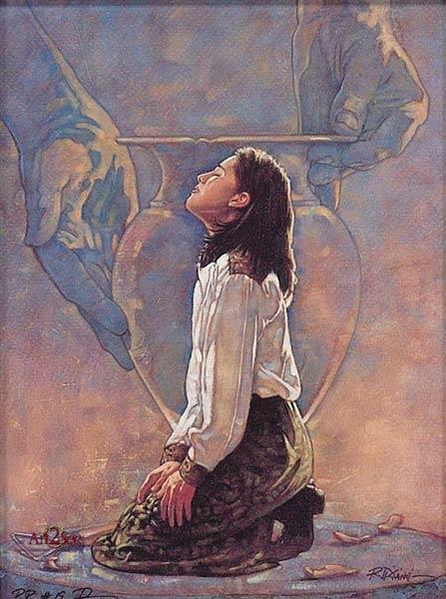
New Testament Gift Lists
6
Gifts (All) | Rom 12:6-8 | Eph 4:11 | 1 Cor 12:28 | 1 Cor 12:29-30 | 1 Cor 12:8-10
Teaching | Teaching |  | Teaching | Teaching
Evangelism |  | Evangelists
Pastor-Teacher |  | Pastor-Teachers
Exhortation | Exhortation
Administration |  |  | Administration
Faith |  |  |  |  | Faith
Giving | Giving
Service | Service |  | Helping
Showing Mercy | Mercy
Apostleship |  | Apostles | Apostles | Apostles
Wisdom |  |  |  |  | Wisdom
Knowledge |  |  |  |  | Knowledge
Prophecy | Prophecy | Prophets | Prophecy | Prophecy | Prophecy
Discerning Spirits |  |  |  |  | Discerning Spirits
Tongues |  |  | Tongues | Tongues | Tongues
Interpretation |  |  |  | Interpretation | Interpretation
Miracles |  |  | Miracles | Miracles | Miracles
Healings |  |  | Healings | Healings | Healings
Speaking
1 Pet. 4:11a
Permanent
Serving
1 Pet. 4:11b
Foundational
Eph. 2:20
Temporary
Sign
Heb. 2:4
Notes:
HS-07-Gifts-40
HS-08-Apostle-06
HS-09-Prophecy-09

Slide 10
1 Corinthians 13:8-12
8 Love never fails. But where there are prophecies, they will cease; where there are tongues, they will be stilled; where there is knowledge, it will pass away.
9 For we know in part and we prophesy in part,
10 but when perfection comes, the imperfect disappears.

Slide 11
1 Corinthians 13:8-12
11 When I was a child, I talked like a child, I thought like a child, I reasoned like a child. When I became a man, I put childish ways behind me.
12 Now we see but a poor reflection as in a mirror; then we shall see face to face. Now I know in part; then I shall know fully, even as I am fully known.

Slide 12


Contrasts Between Farnell & Grudem on Prophecy
Small Group Questions:
Which difference between these two definitions was most significant to you?
Why?

Slide 13
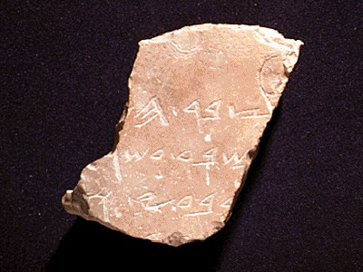
Definitions
23
Hebrew: nabi
a mouthpiece for God
"spokesman, speaker, prophet"
Greek:
prophetes
"one who speaks for God, proclaiming what God wants to make known"

Slide 14
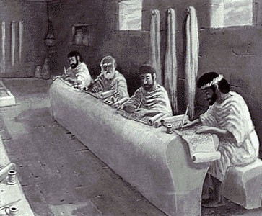
Why Are Requirements of True Prophecy Necessary?
23
God's character demands accuracy concerning His Word.
False prophets were executed (Deut. 18:21-22).

Slide 15

What is Prophecy?
"knowing this first of all, that no prophecy of Scripture comes from someone's own interpretation. For no prophecy was ever produced by the will of man, but men spoke from God as they were carried along by the Holy Spirit"
2 Peter 1:20-21 (ESV)

Slide 16
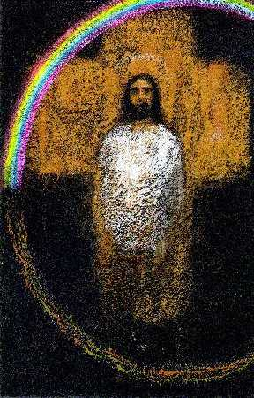
Prophecy of a Prophet given through Moses (Deut. 18:15)
23
"I will raise up a prophet like you from among their fellow Israelites. I will put my words in his mouth, and he will tell the people everything I command him."

Slide 17

Tests of a True Prophet (Deut. 18:20, 22)
23
Worships the LORD
Predictions 100% true
"But any prophet who falsely claims to speak in my name or who speaks in the name of another god must die…If the prophet speaks in the Lord's name but his prediction does not happen or come true, you will know that the Lord did not give that message. That prophet has spoken without my authority and need not be feared."

Slide 18
The hierarchy of gifts shows prophets right after apostles
(1 Cor. 12:28-30).
23
“And in the church God has appointed
first of all apostles,
second prophets,
third teachers,
then workers of miracles,
also those having gifts of healing,
those able to help others,
those with gifts of administration,
and those speaking in different kinds of tongues.”
“Are all apostles? Are all prophets? Are all teachers?
Do all work miracles? Do all have gifts of healing?
Do all speak in tongues? Do all interpret?”
Notes:
18

Slide 19
Emphasize the gifts that edify the most members (12:31).
23
1 Corinthians 12:31 "But eagerly desire the greater gifts."
"desire" = "all of you desire" (second person plural)
"greater gifts" = 12:28
Notes:
19

Slide 20
Why Are Requirements of True Prophecy Necessary?
186
God's character demands accuracy concerning His Word.
False prophets were executed (Deut 18:21-22).
Many today claim to utter prophecies from God—so we must be able to discern truth from error.
Equipping comes from knowing God's Word (2 Tim. 3:16-17).

Slide 21
WHY IS GOD'S WORD SO VITAL?
"All Scripture is God-breathed and is useful for teaching, rebuking, correcting and training in righteousness, so that the man of God may be thoroughly equipped for every good work."
2 Timothy 3:16-17 (NIV)

Slide 22
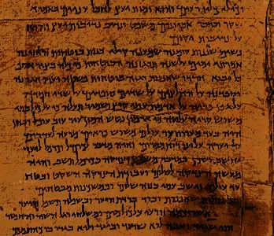
How are Prophets Different?
OTB 186b
Biblical
Pagan
Godly character
Immoral
Mostly men
Mostly women
Inspired
Own thoughts
Own style
Demon possessed

Slide 23
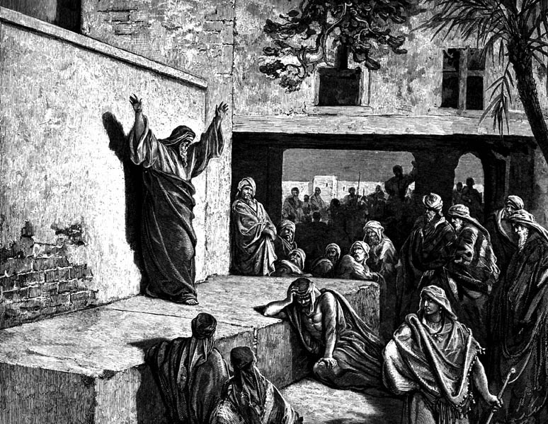
Jeremiah (25:11-12) vs. Hananiah (28:2-3)
True
False
"You'll
stay 70
years!"
"You'll return in 2 years!"
Lived 23 years more (51:64)
Died 2 months later (28:17)

Slide 24
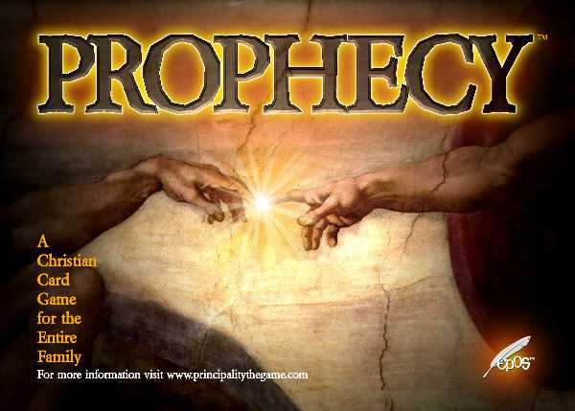
"Let love be your highest goal! But you should also desire the special abilities the Spirit gives–especially the ability to prophesy" (1 Cor 14:1 NLT)

Slide 25

But why emphasize prophecy over tongues?
(3 reasons in 1 Cor. 14)
over
TONGUES
Notes:
25

Slide 26
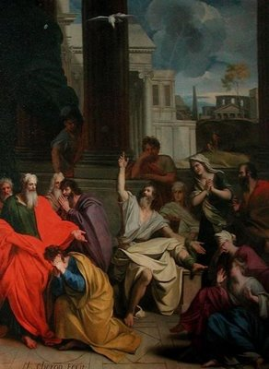
I. Prophecy benefits other believers
(1 Cor 14:2-5)
Notes:
26

Slide 27

A. Prophecy is understood by others while tongues is understood only by God (1 Cor 14:2-3).
"For if you have the ability to speak in tongues, you will be talking only to God,
since people won't be able to understand you. You will be speaking by the power of the Spirit, but it will all be mysterious.
³But one who prophesies strengthens others, encourages them, and comforts them" (NLT).
Notes:
27

Slide 28

PROPHECY
23
"The God-given ability to receive divine revelation and declare it to God's people in their own language without error"

Slide 29
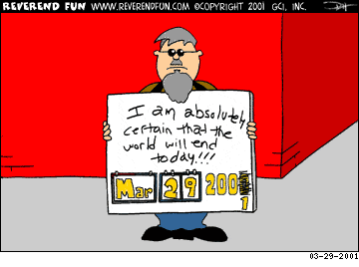
False prophecies change

Slide 30

A Stern Warning (Rev. 22:18-19)
"I warn everyone who hears the prophecy of this book:
If anyone adds anything to them, God will add to him the plagues described in this book.
If anyone takes words away from this book of prophecy, God will take away from him his share in the tree of life and the holy city, which are described in this book"

Slide 31
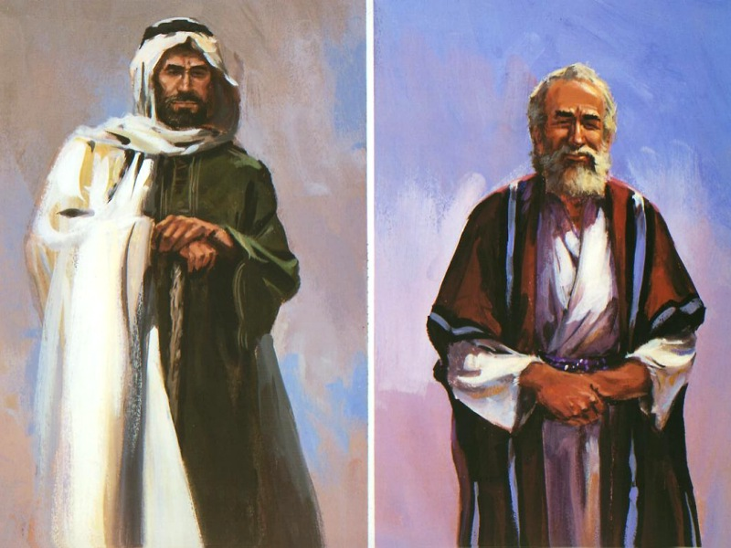
The Two Witnesses (Rev. 11:3)
"And I will give power to my two witnesses, and they will be clothed in burlap and will prophesy during those 1,260 days."

Slide 32
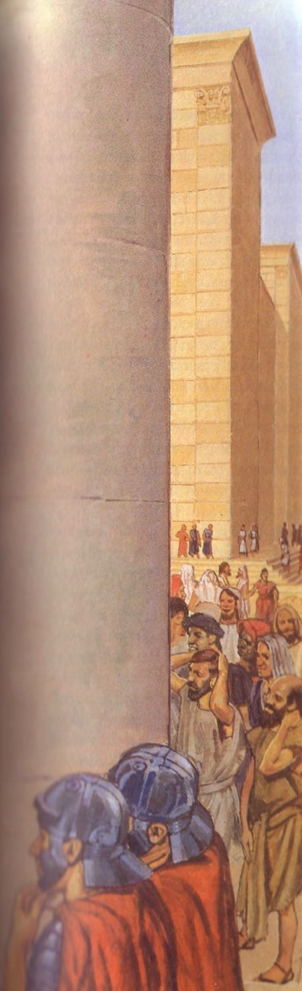
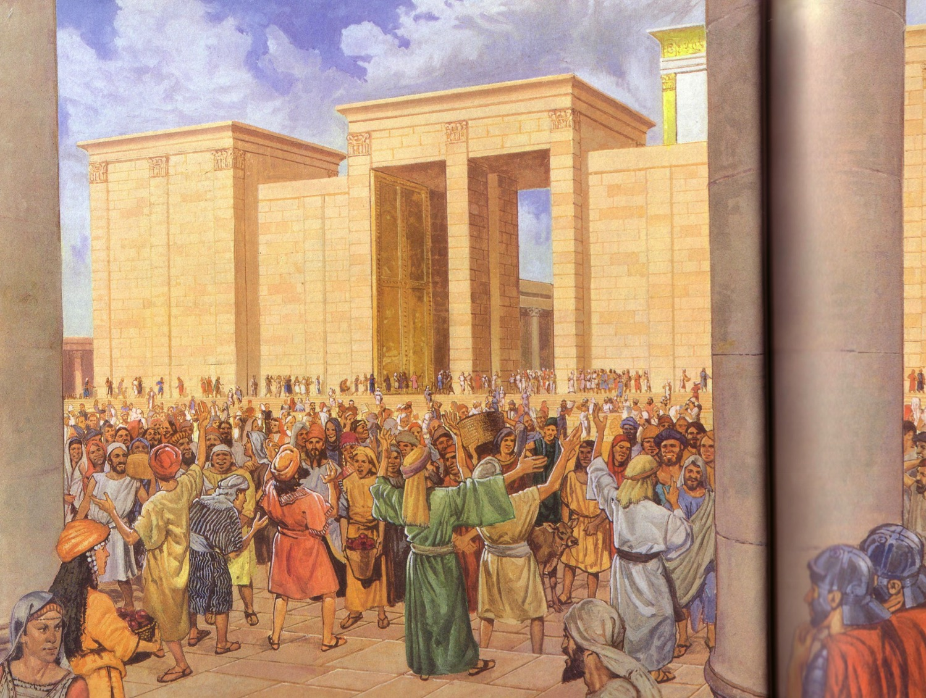
Apostles praised God in languages they had never learned (Acts 2)
Egyptian
Persian
Arabic
Median
Latin
Etc.

Slide 33
A. Prophecy is understood by others while tongues is understood only by God (1 Cor 14:2-3).
²For if you have the ability to speak in tongues, you will be talking only to God,
since people won't be able to understand you. You will be speaking by the power of the Spirit, but it will all be mysterious.
³But one who prophesies strengthens others, encourages them, and comforts them (NLT).
Notes:
33

Slide 34
B. Prophecy edifies the church while tongues only edifies the speaker (1 Cor 14:4-5).
⁴A person who speaks in tongues is strengthened personally, but one who speaks a word of prophecy strengthens the entire church.
⁵I wish you could all speak in tongues, but even more I wish you could all prophesy. For prophecy is greater than speaking in tongues, unless someone interprets what you are saying so that the whole church will be strengthened (NLT).
Notes:
34

Slide 35
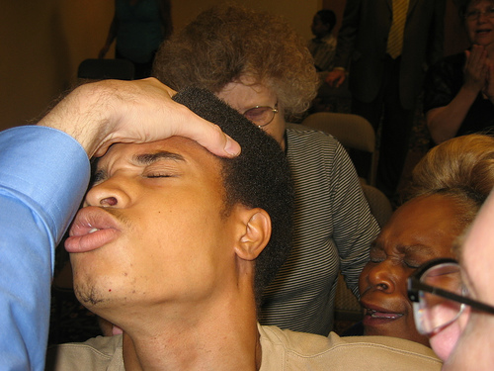
II. Uninterpreted tongues are incomprehensible (1 Cor 14:6-19)
Notes:
35

Slide 36
Tongues benefit no one unless they reveal God's will (1 Cor. 14:6 NAU)
6 But now, brethren, if I come to you speaking in tongues, what will I profit you unless I speak to you either by way of revelation or of knowledge or of prophecy or of teaching?

Slide 37
Tongues without interpretation don't communicate like musical instruments that don't distinguish notes (14:7-9 NAU).
7 Yet even lifeless things, either flute or harp…if they do not produce a distinction in the tones, how will it be known what is played on the flute or on the harp? 8 For if the bugle produces an indistinct sound, who will prepare himself for battle? 9 So also you, unless you utter by the tongue speech that is clear, how will it be known what is spoken? For you will be speaking into the air.

Slide 38
Emphasize intelligible gifts more than uninterpreted tongues (14:10-12 NAU)
10 There are, perhaps, a great many kinds of languages in the world, and no kind is without meaning. 11 If then I do not know the meaning of the language, I will be to the one who speaks a barbarian, and the one who speaks will be a barbarian to me. 12 So also you, since you are zealous of spiritual gifts, seek to abound for the edification of the church.

Slide 39
Prayer and singing are superior only when understood because this edifies people
(14:13-17 NAU)
13 Therefore let one who speaks in a tongue pray that he may interpret. 14 For if I pray in a tongue, my spirit prays, but my mind is unfruitful. 15 What is the outcome then? I will pray with the spirit and I will pray with the mind also; I will sing with the spirit and I will sing with the mind also.

Slide 40
Prayer and singing are superior only when understood because this edifies people
(14:13-17 NAU)
16 Otherwise if you bless in the spirit only, how will the one who fills the place of the ungifted say the "Amen" at your giving of thanks, since he does not know what you are saying? 17 For you are giving thanks well enough, but the other person is not edified.

Slide 41
A little understandable prophecy is better than a lot of incomprehensible tongues (14:18-19 NAU)
18 I thank God, I speak in tongues more than you all; 19 however, in the church I desire to speak five words with my mind so that I may instruct others also, rather than ten thousand words in a tongue.

Slide 42
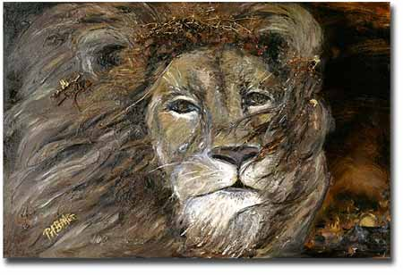
III. Prophecy has a superior purpose and results
(1 Cor 12:20-25).
Notes:
42

Slide 43
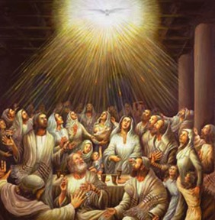
A. Prophecy has a superior purpose (20-22).
Far superior is prophecy, for prophecy edifies believers (22b)
Tongues authenticate God's work to unbelievers (21-22a)
Notes:
43

Slide 44
A. Prophecy has a superior purpose (20-22).
Far superior is prophecy, for prophecy edifies believers (22b)
Tongues authenticate God's work to unbelievers (21-22a)
Notes:
44

Slide 45
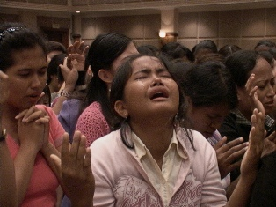
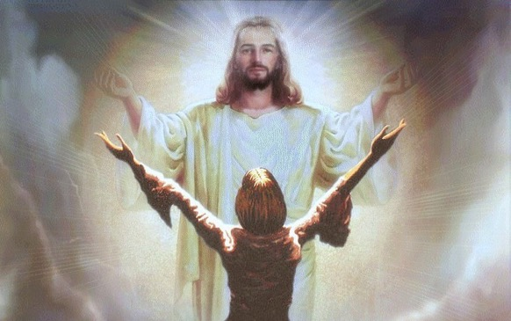
B. Prophecy has superior results (23-25).
But prophecy brings conviction, repentance, and worship for unbelievers in the assembly (24-25)
Uninterpreted tongues turns off unbelievers in the assembly (23)
Notes:
45

Slide 46

God's Word must have the highest priority in public worship (Main Idea)
Home group
CSB
Take notes
Bring a Bible
"No Bible,
no breakfast"

Slide 47
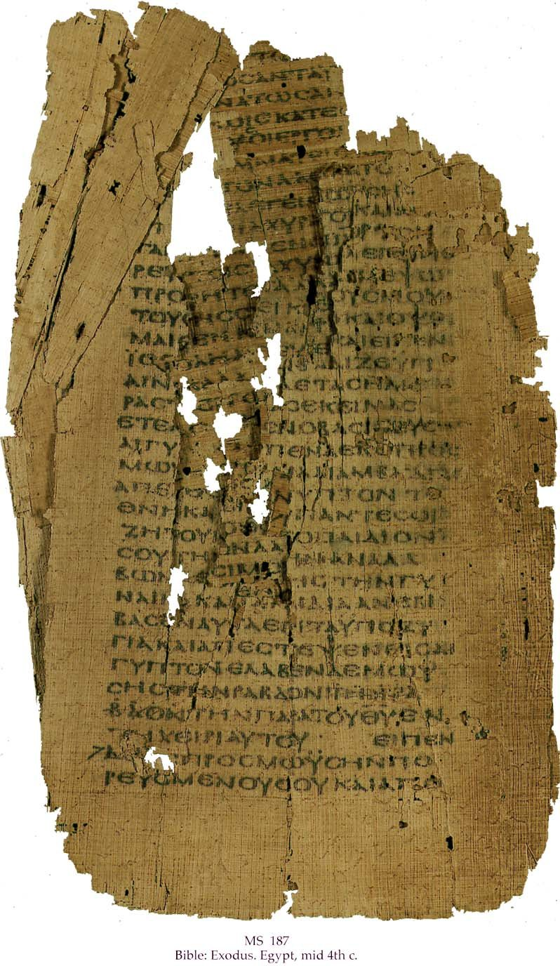
How are Prophets Different?
OTB 186c-d
Biblical
Pagan
Godly Motive
Financial Gain
Original messages
Plagiarism
100% accurate
Errors of fulfillment
Persecuted
Exalted

Slide 48
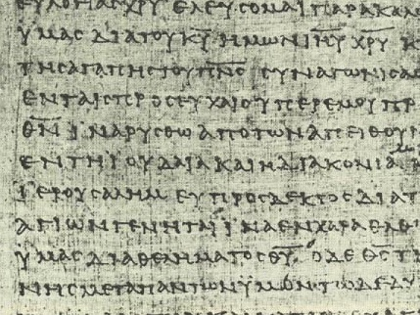
DISCUSSION GROUP A
OTB 186e
What should a church do with a so-called prophet who:
predicts false events
falls into moral sin, or
leads people to false gods?

Slide 49

DISCUSSION GROUP B
OTB 186e
Is prophecy "telling something that God has spontaneously brought to mind" (Wayne Grudem)?
Can true prophecy contain errors?
Why or why not?

Slide 50

DISCUSSION GROUP C
OTB 186e
Do you think Grudem's teaching that all believers can prophesy has biblical support (cf. 1 Cor. 12:29 vs. 14:1)?
Support your answer.

Slide 51
DISCUSSION GROUP D
OTB 186e
What would you say to someone who claimed that his prophecy is inspired but not equal in authority to Scripture?
Are there different levels of inspiration or inerrancy?

Slide 52
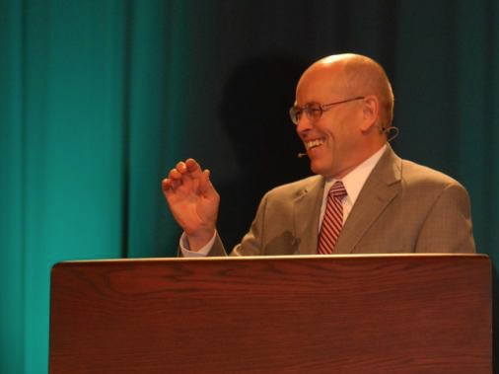
Wayne Grudem's
Definition of Prophecy
124
"telling something that God has spontaneously brought to mind"
"Why Christians Can Still Prophesy" Christianity Today (16 Sept 1988), 29

Slide 53

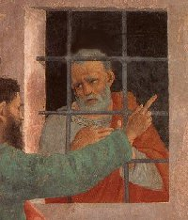
Agabus
Prophesied Paul to be bound by:
After we had been there a number of days, a prophet named Agabus came down from Judea. ¹¹Coming over to us, he took Paul's belt, tied his own hands and feet with it and said, "The Holy Spirit says, 'In this way the Jews of Jerusalem will bind the owner of this belt and will hand him over to the Gentiles'"
(Acts 21:10-11).
Is this a Spirit-inspired prophecy with
"inaccuracy of detail" (Grudem)? No!
• Jews (Acts 21:10-11)
• Romans (Acts 21:33)
• Jews caused the riot (21:27)!
"Then the [Roman] commander arrested him and ordered him bound with two chains. He asked the crowd who he was and what he had done
(Acts 21:33).
"The seven days were almost ended when some Jews from the province of Asia saw Paul in the Temple and roused a mob against him. They grabbed him (Acts 21:27).
Notes:
53

Slide 54
Summary of Prophetic Views
26
Grudem's View
Biblical View
Prophecy is declaring anything (true or false) that the Spirit brings to one's mind
Prophecy is declaring God's inspired and inerrant revelation to others
The above definition was invented
in 1988 by Wayne Grudem
The above definition has been the teaching of the church for 20 centuries
OT prophets are parallel to NT apostles
OT prophets are parallel to NT prophets
God changed the definition of prophecy from the OT to the NT
God kept the meaning of prophecy consistent between the two testaments
God gives some prophecies with errors
God gives all prophecies without errors
(2 Pet. 1:20-21)
Any believer can prophesy
Only those with the gift of prophecy can prophesy (1 Cor. 12:29)
There's two kinds of NT prophecy
(fallible and infallible)
There's one kind of NT prophecy
(infallible)
Fallible prophecy can be inspired
Fallible prophecy is false prophecy
(Deut. 13:1-5; 18:14-20)
God sometimes lies
God always tells the truth since He cannot lie (Heb. 6:18)

Slide 55
Tongues verses Prophecy
34
Tongues
Prophecy
Value
Inferior (14:5a)
Superior (14:1)
Relation to Other Gifts
The least important gift (12:28)
The second most important gift (12:28)
Language Used
Foreign (14:10)
Vernacular (14:19)
Corollary Gift
Interpretation of tongues (12:30; 14:27-28)
Discerning of spirits
(12:10; 14:29)
Speaker's Knowledge of Language
Unknown: "utters mysteries with his spirit…my spirit prays but my mind is unfruitful" (14:2b, 14)
Known: "pray with my spirit [and] with my mind" (14:15, 19)
Value (without Interpretation)
Harmful: people cannot understand and thus are not edified (14:16-17, 23, 28)
Great: people can understand and thus are edified (14:5b, 24-25)
Edification (without Interpretation)
Self only (14:4a; cf. 10:24; 12:7, 11)
Entire church (14:4b)

Slide 56
Tongues verses Prophecy
34
Tongues
Prophecy
Direction of Speech is to…
God (14:2)
Men (14:3)
Result in Others
Revelation, knowledge, prophecy, word of instruction (14:6)
Strengthening, encouragement, and comfort (14:3b)
Type of Communication
Speaking (14:6), prayer (14:14), praise (14:16), singing? (14:15b)
Foretelling the future, "forthtelling" or declaring doctrinal truth (14:19)
Purpose
Sign to unbelieving Jews (14:21-22a)
Message to believers (14:22b)
Limitations
Two or three tongues messages in each service (14:27a), speak in turn (14:27b), someone must interpret (14:27c-28)
Two or three prophetic messages in each service (14:29a), speak in turn (14:30-31), weigh what is said (14:29b, 32)
Exhortation
Negative: Do not forbid tongues (14:39b)
Positive: Be eager to prophesy (14:39a)
Agent of Cessation
Self: middle voice (13:8b)
Someone other than self: passive voice (13:8a)

Slide 57
Prophecy versus Teaching
27
Teaching
Prophecy
Value
Inferior: Teaching is listed after prophecy in the leadership structure of the church at Antioch (Acts 13:1)
Superior: Prophecy has a long OT history of declaring an uninterpreted word of God (2 Pet. 1:20-21) whereas teachers must interpret it
Relation to the Other Gift
A less important gift: listed after prophecy in the priority of the gifts (1 Cor. 12:28)
The second most important gift, superseded only by apostleship (1 Cor. 12:28)
Authority
Less authoritative than prophecy as the teacher must interpret God's written Word
More authoritative than teaching since the spoken word is inspired and uninterpreted (2 Pet. 1:20-21)
Source of Truth is…
God's Word (Col. 3:16)
God's Spirit (2 Pet. 1:21)
Revelatory Nature
Uninspired explanation of already revealed truth (Acts 15:35; 11:12, 26; Rom. 2:21; 15:4; Heb. 5:12)
Inspired foretelling the future or "forth-telling" (declaring doctrinal truth) received by revelation (1 Cor. 14:19, 26, 29-30; Eph. 3:5)

Slide 58
Prophecy versus Teaching
27
Teaching
Prophecy
Style
Systematic
Spontaneous (Acts 11:28; 21:4, 10-11)
Limitations
No limitation on teaching is given in church services
2-3 prophetic messages per service (14:29a), speak in turn (14:30-31),
weigh what is said (14:29b, 32)
Leadership Requirements
Required of elders (1 Tim. 3:2; 5:17; Tit. 1:9) since the church needs continued teaching of truth through its history
Not required of elders as this would provide too high a standard; also, revelation need not continue after the canon is complete (Rev. 22:18-19)
Foundation for the Church
Not foundational for the Church—the foundation is not in interpreted messages but in divinely spoken and written messages from God by apostles and prophets
Foundational for the Church along with apostleship (Eph. 2:20), which means that it need not continue through Church history since the foundation is provided once-for-all (e.g., no apostles today)
Cessation
No hint is given in the NT that this gift has ceased or will do so in the church age
The gift will cease by someone other than self: passive voice (1 Cor. 13:8a; cf. Spiritual Gifts notes, 29)

Slide 59
Distinguishing of Spirits
28
"The spiritual capacity to determine whether a teacher, prophet, or preacher is speaking under the impulse of
the Holy Spirit,
his own spirit, or
evil spirits"
--Bill McRae, The Dynamics of Spiritual Gifts, 73

Slide 60

Discern Prophecy!
1 Cor. 14:29 NLT Let two or three people prophesy, and let the others evaluate what is said. ³⁰But if someone is prophesying and another person receives a revelation from the Lord, the one who is speaking must stop. ³¹In this way, all who prophesy will have a turn to speak, one after the other, so that everyone will learn and be encouraged. ³²Remember that people who prophesy are in control of their spirit and can take turns. ³³For God is not a God of disorder but of peace, as in all the meetings of God's holy people.
Notes:
60

Slide 61
Let's hold God's Word in the highest regard!
In our personal devotional lives
In our families
In our work
In our Bible studies (including tonight)

Slide 62
Black

Slide 63

Holy Spirit PPT link at BibleStudyDownloads.org
Get this presentation for free!

